Slide 1
CAUSE OF DEATH
Submitted by- ashish bhakte

Slide 2
About Dataset
A straightforward way to assess the health status of a population is to focus on mortality – or concepts like child mortality or life expectancy, which are based on mortality estimates. A focus on mortality, however, does not take into account that the burden of diseases is not only that they kill people, but that they cause suffering to people who live with them. Assessing health outcomes by both mortality and morbidity (the prevalent diseases) provides a more encompassing view on health outcomes. This is the topic of this entry. The sum of mortality and morbidity is referred to as the ‘burden of disease’ and can be measured by a metric called ‘disability adjusted life years‘ (dalys).
DALYs are measuring lost health and are a standardized metric that allow for direct comparisons of disease burdens of different diseases across countries, between different populations, and over time. Conceptually, one DALY is the equivalent of losing one year in good health because of either premature death or disease or disability. One DALY represents one lost year of healthy life. The first ‘Global burden of disease’ (Gbd) was Gbd 1990 and the daly metric was prominently featured in the world bank’s 1993 World Development Report. Today it is published by both the researchers at the Institute of Health Metrics and evaluation (ihme) and the ‘disease burden unit’ at the world Health Organization (WHO), which was created in 1998. The IHME continues the work that was started in the early 1990s and publishes the Global Burden of Disease study.

Slide 3
Content
in this Dataset, we have Historical Data of different cause of deaths for all ages around the World. The key features of this Dataset are: Meningitis, Alzheimer's Disease and Other Dementias, Parkinson's Disease, Nutritional Deficiencies, Malaria, Drowning, Interpersonal Violence, Maternal Disorders, HIV/AIDS, Drug Use Disorders, Tuberculosis, Cardiovascular Diseases, Lower Respiratory Infections, Neonatal Disorders, Alcohol Use Disorders, Self-harm, Exposure to Forces of Nature, Diarrheal Diseases, Environmental Heat and Cold Exposure, Neoplasms, Conflict and Terrorism, Diabetes Mellitus, Chronic Kidney Disease, Poisonings, Protein-Energy Malnutrition, Road Injuries, Chronic Respiratory Diseases, Cirrhosis and Other Chronic Liver Diseases, Digestive Diseases, Fire, Heat, and Hot Substances, Acute Hepatitis.

Slide 4
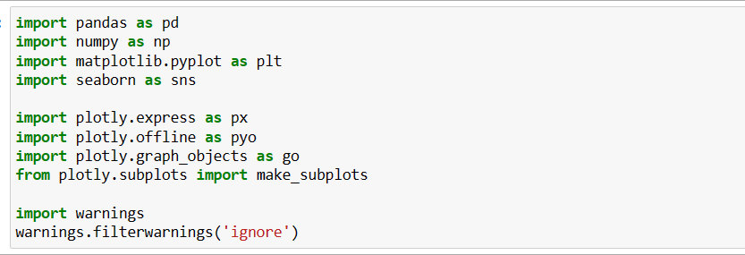
Importing Libraries

Slide 5
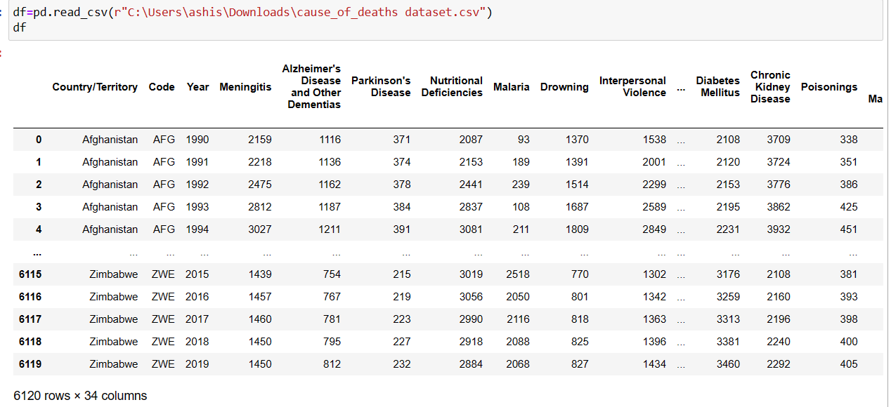
Importing Dataset –Display The Dataset

Slide 6
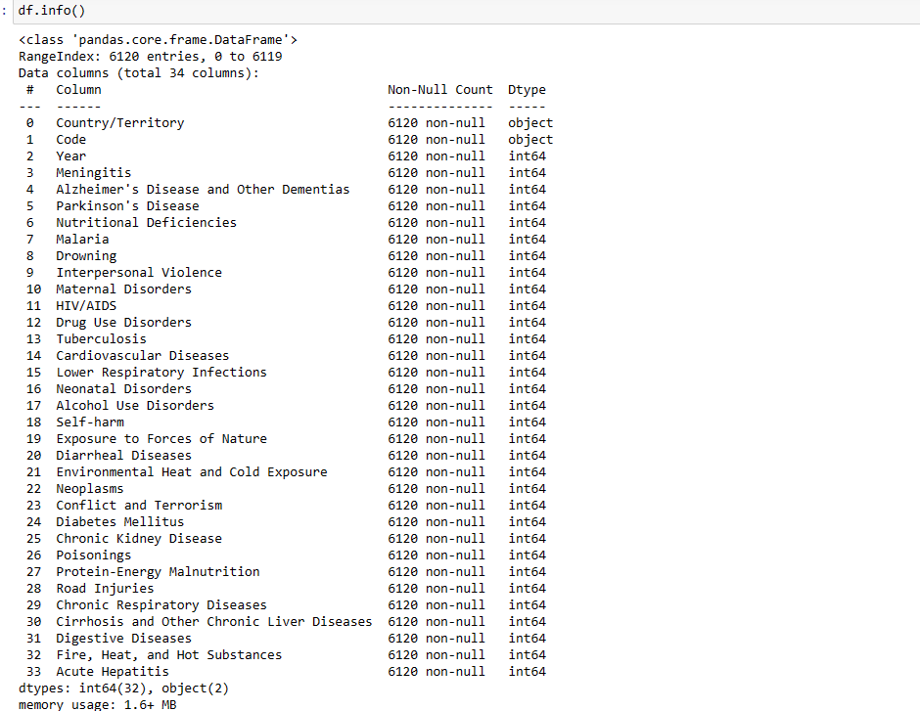
Check The Data Information

Slide 7
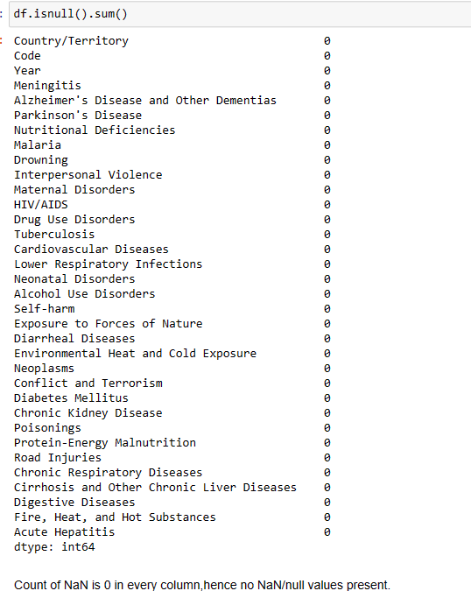
Check The Null Value In Dataset

Slide 8
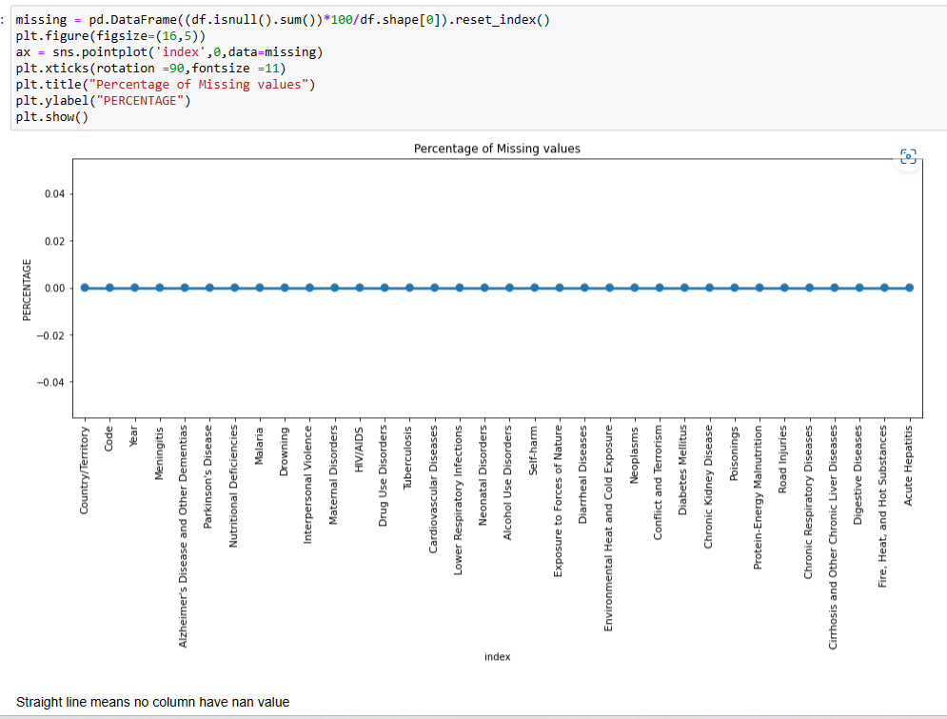
Check The Null Value In Dataset (Visualization)

Slide 9
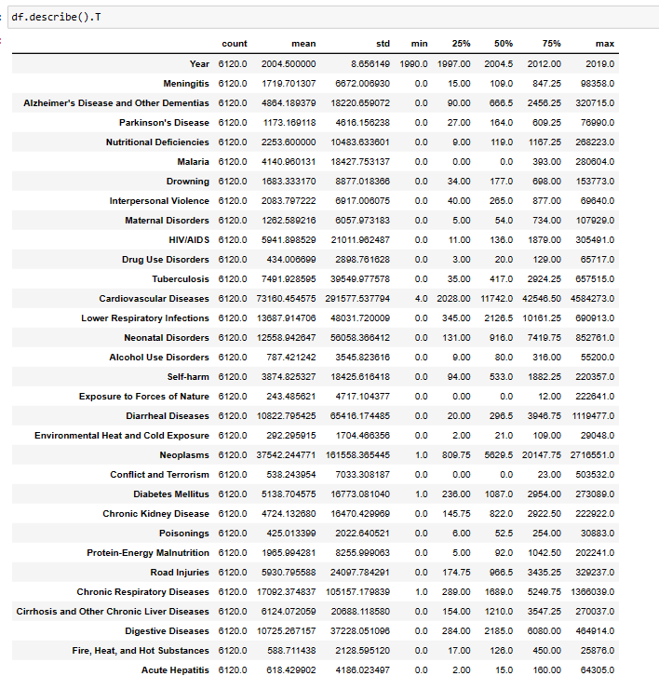
Describe the Dataset
Here we have described the whole dataset by DESCRIBE command ..
We can see the count of all the columns that is 6120 which means no Null value is present in the dataset..
We can see the mean and standard deviation of all the Numeric columns in the dataset.
We can see the Min and Max from all the columns.
We can see Quartiles over here too

Slide 10
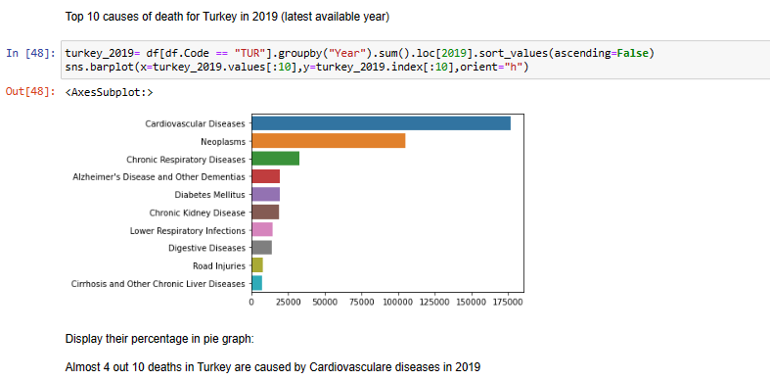
Visualization

Slide 11
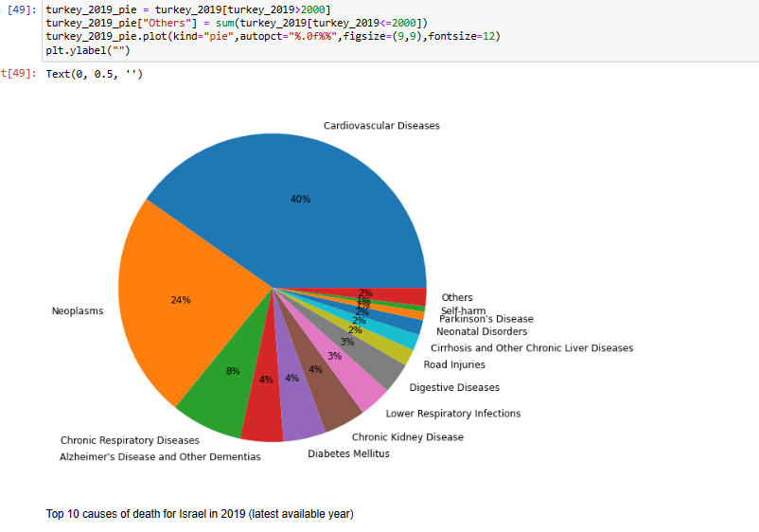
Visualization

Slide 12
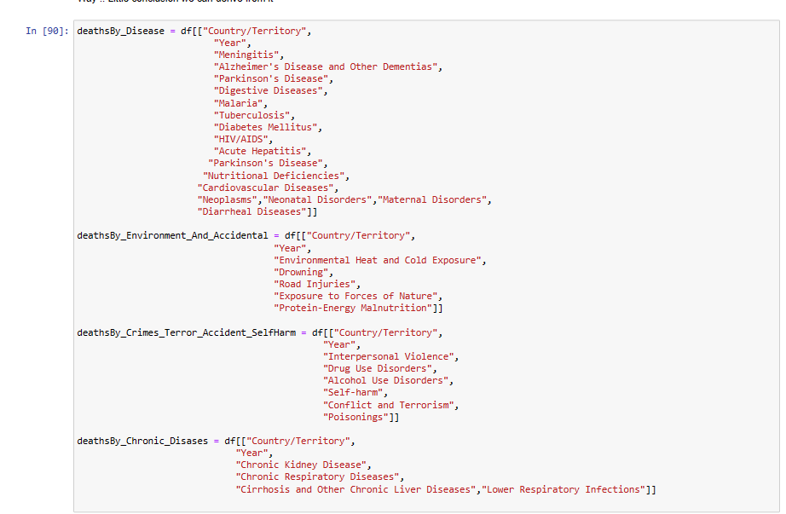
Divide factor of Death into 4 Categories

Slide 13
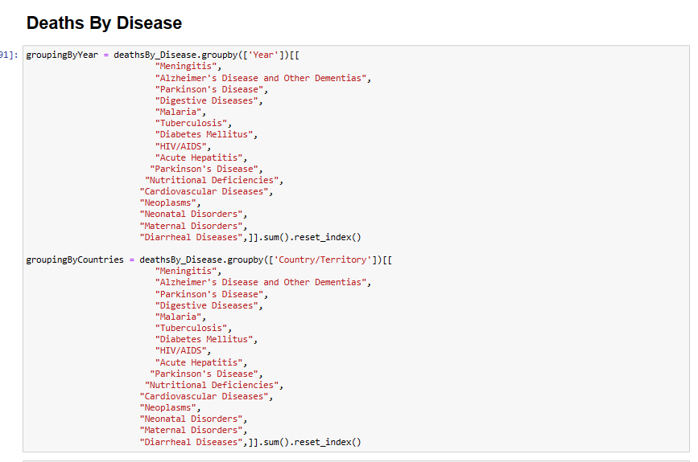
Analysis As per death by Dieses-

Slide 14
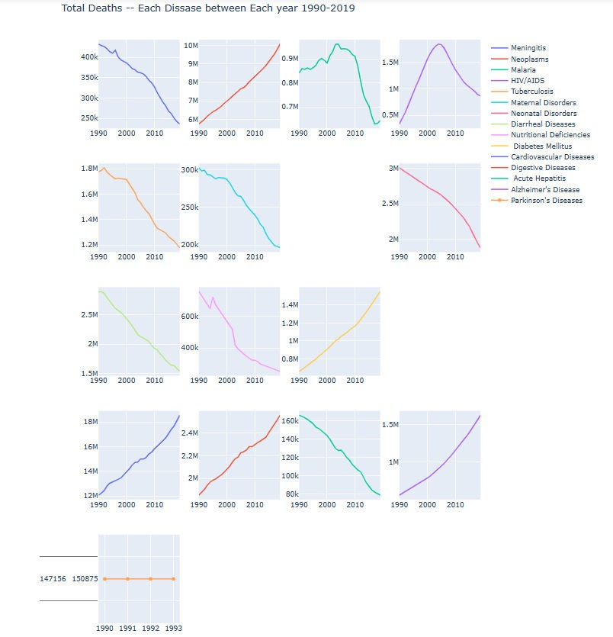
Plotting per death by Dieses-
This is Plot shows how much Death has taken places by Diseases In all the year sinces 1990-2019

Slide 15
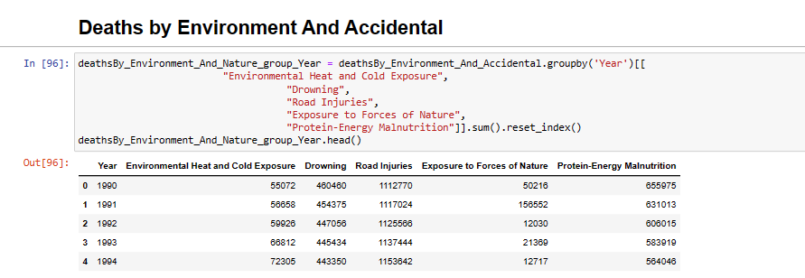
Death by Environment & Accidental-

Slide 16
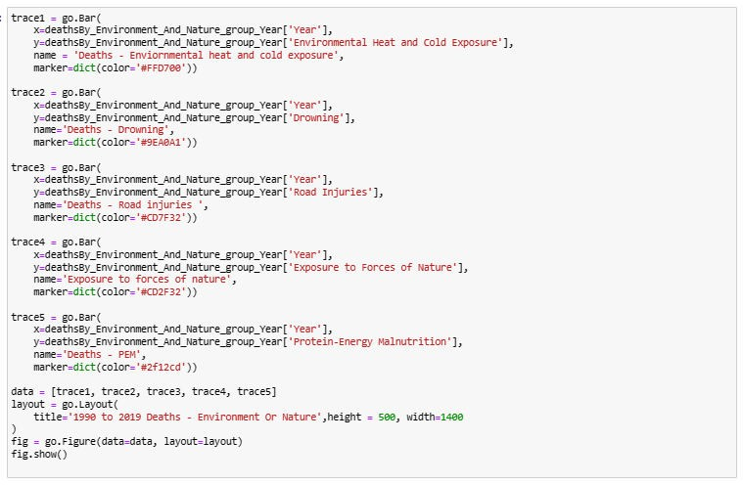
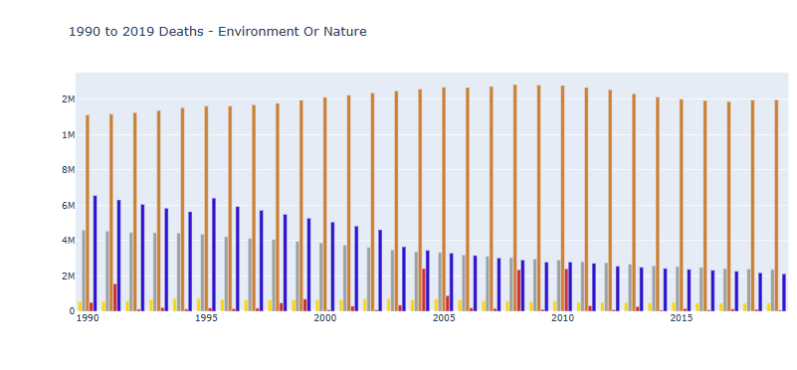

Slide 17
Here following color is representing following columns :-
Yellow :- Environmental Heat and Cold Exposure
Grey :- Deaths - Drowning
Orange :- Road Injuries
Blue :- Protein-Energy Malnutrition(PEM)

Slide 18
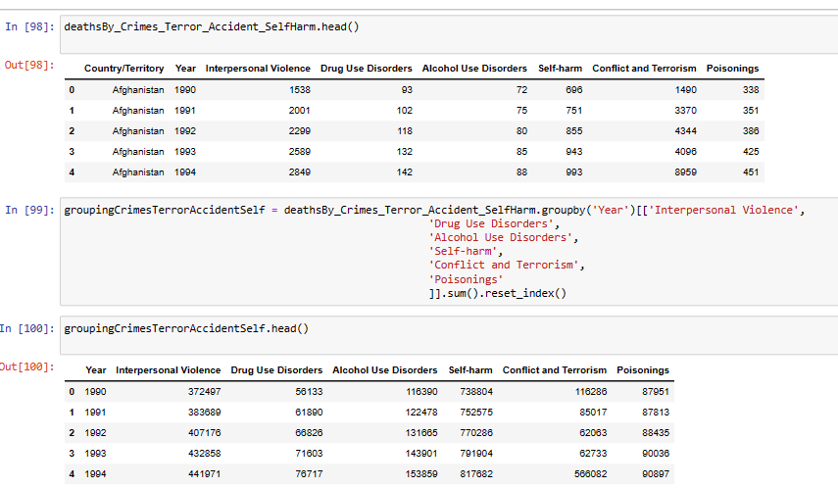
Death by Crime ,Terror,Self_Harm

Slide 19
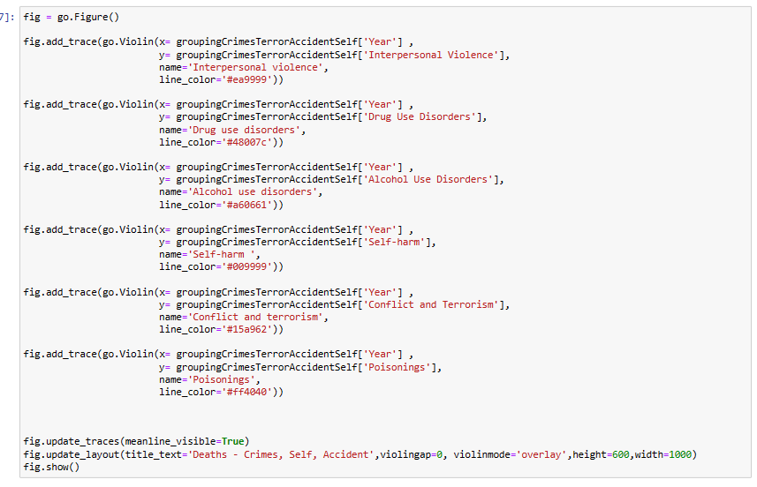
Death by Crime ,Terror,Self_Harm

Slide 20
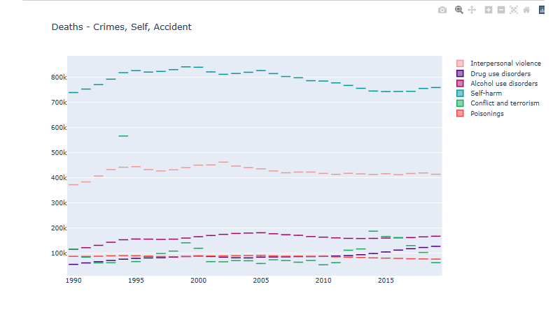
Death by Crime ,Terror,Self_Harm
We can clearly see in this plot which shows CRIMES_TERROR_ACCIDENT_SELF-HARM and here
come to know that in all the years the maximum death have
been taken place by Conflicts and Terrorism and the max death was in between 1990 and 2000.
Poisoning seems to be constant in all the years.
The second highest death has taken place by Interpersonal violence
And rest all the case of seems to be under 200k in all the given years.

Slide 21
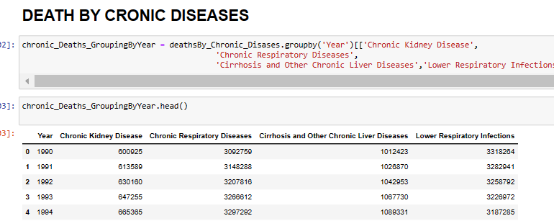
Death by Chronic Diesses

Slide 22
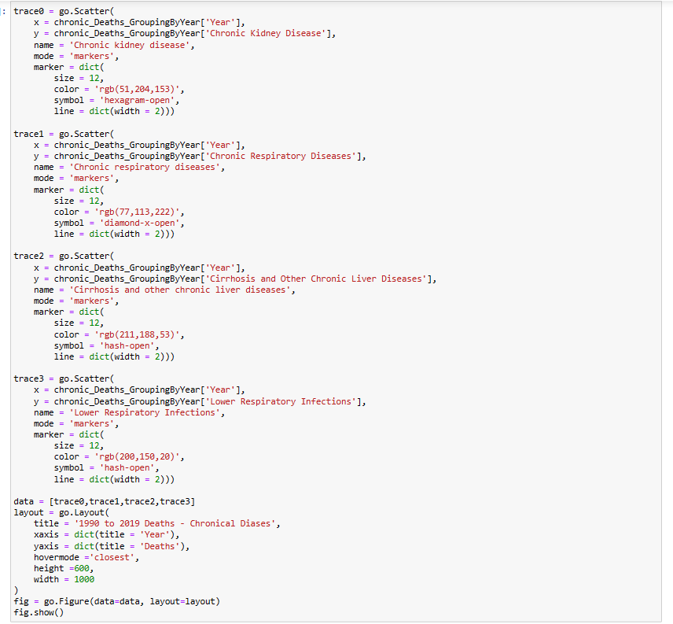
Death by Chronic Diesses

Slide 23
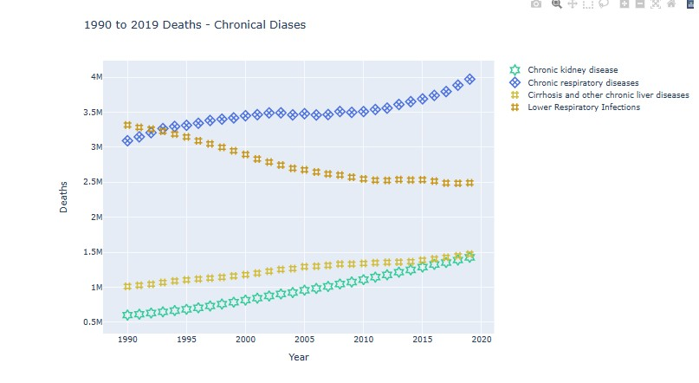
Death by Chronic Diesses
WE CAN SEE THAT THE MAXIMUM DEATH IS CAUSED BY CHRONIC RESPIRATORY DISEASES AND LEAST DEATH IS CAUSED BY CHRONIC KIDNEY DISEASES IN ALL THE GIVEN YEARS WHICH IS 1990 TO 2019.

Slide 24
Conclusion:-
otal rows 6120 and 34 columns in the dataset .
I found out that there are many diseases which continiously increasing such as Neoplasms,HIV/AIDS,Diabetes,Cardiovascular Diseases,Digestive disorder and Alzheimer. I Found out that there are many disease which are continously decreasing too such as Acute Hepatitis,Diarrheal Diseases,Nutritional Diseases and Meningitis. Parkinson Diseases seems to be constants till 1990 to 1993 after that no data is present for the same. We can see that in all the given years i.e 1990 to 2019 ,Road accident have taken Maximum lifes and the least can death can be seen in Exposure to force of Nature. In case of Death by crime ,self-harm and Accident -> Maximum death have been taken place by Conflict and Terroism and the second highest death have been recorded by -Interpersonal Violence.
Rest all other factors of death are under 200k which can be even further minimized ALL THE GOVERNMENT AND CONCERNED BODIES SHOULD TAKE RESONABLE STEP TO ENSURE THAT ALL THE AREAS WITH MAXIMUM DEATHS CAN BE MINIMIZED AND PROPER ACTION SHOULD BE TAKEN IN CASE OF CONFLICT &TERRIOSM AND INTERPERSONAL VIOLENCE SO THAT IT SHOULD BE REDUCED TO MINIMAL.

